Slide 1

Diabetic Prediction Using Neural Network Model
Presented By: John Manuel

Slide 2
Facts About The Data Set
The data is sourced from the health information of PIMA Indians who are a group of Native American people who traditionally lived in what is now Central and Southern Arizona.
The Pima Indian community in Arizona has the highest rates of Type 2 Diabetes in the world.
The Pima Indians Diabetes Dataset was recorded between 1960’s and 1970’s
The data was collected by the U.S. National Institute of Diabetes and Digestive and Kidney Diseases (NIDDK) to study the factors contributing to diabetes in the population.
The dataset has 768 rows & 9 columns: ‘Pregnancies’, ‘Glucose’, ‘Blood Pressure’, ‘SkinThickness’, ‘Insulin’, ‘BMI’, ‘DiabetesPedigreeFunction’, ‘Age’, and ‘Outcome’.
No missing values, but 0 in columns ‘Glucose’, ‘Blood Pressure’, ‘SkinThickness’, ‘Insulin’, ‘BMI’ are not valid values due to the nature of the columns. Replaced with NaN

Slide 3
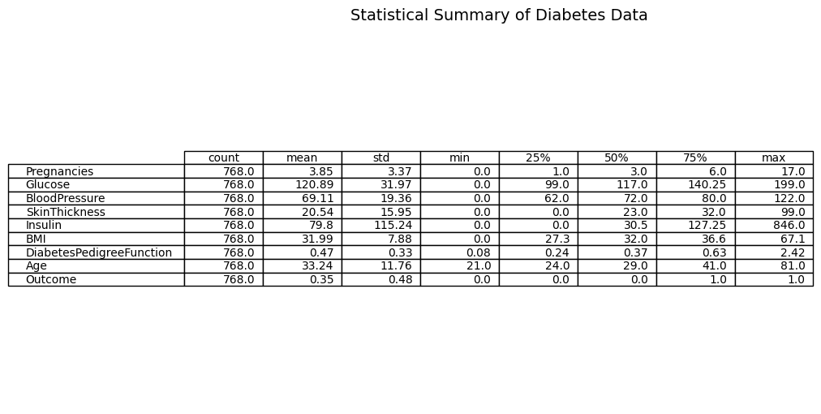
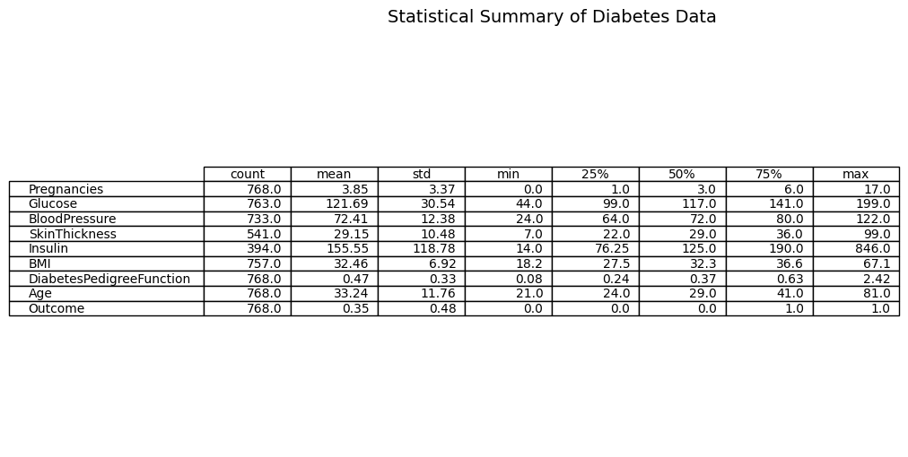
Summary of Diabetes Data
Before replacing 0’s with NaN
After replacing 0’s with NaN

Slide 4
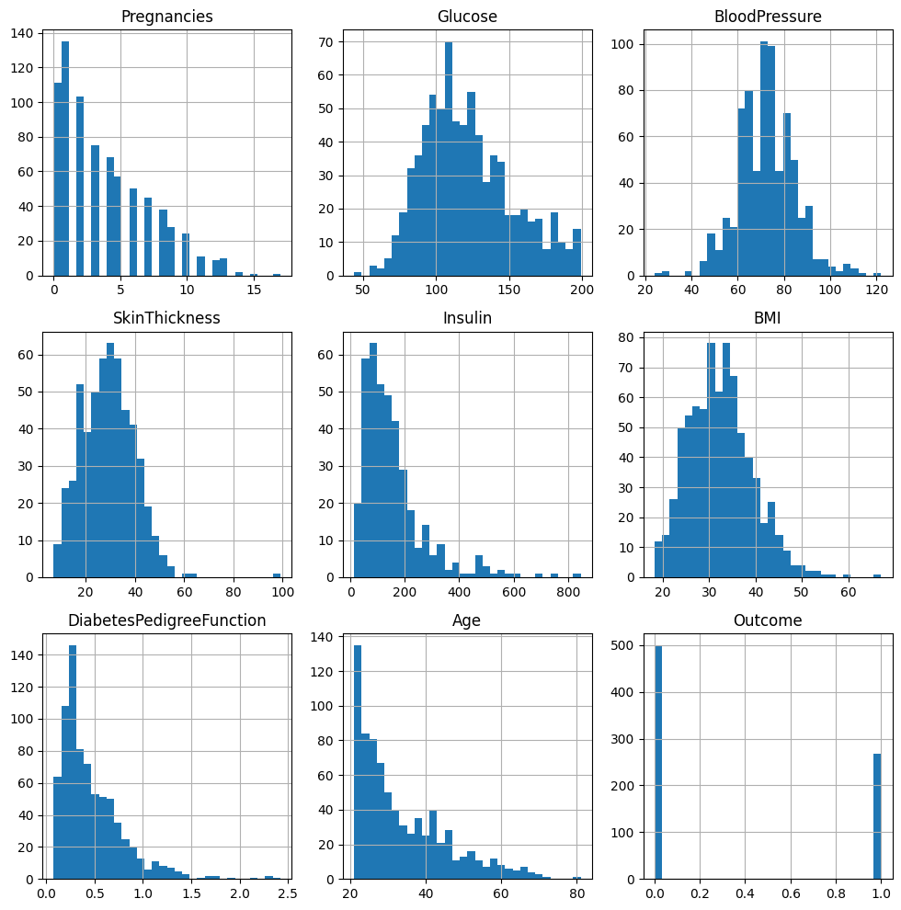
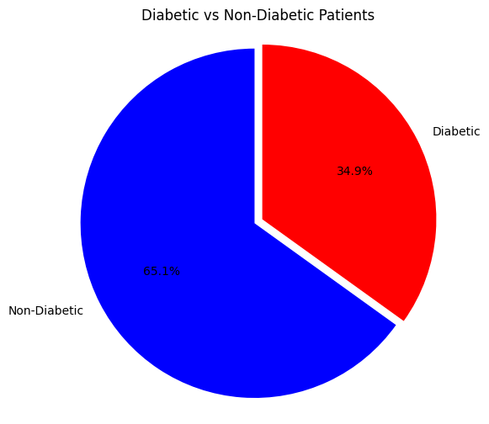
Visual Data Presentation

Slide 5
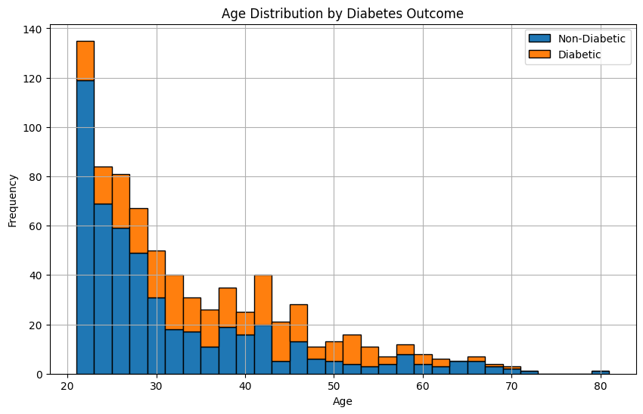
Age Distribution by Diabetes Outcome

Slide 6
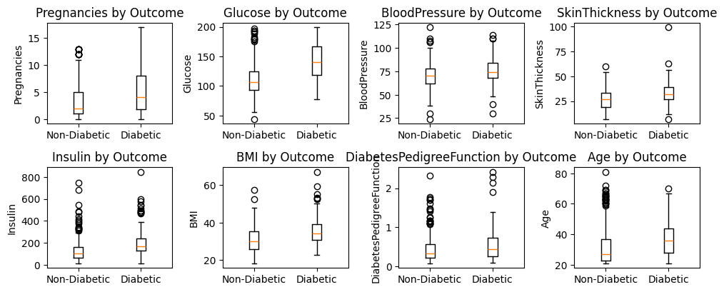
Boxplots vs Outcome
Notes:
What does the data show? Pregnancies are higher among diabetics but have many outliers.
Diabetics have a much higher glucose level (a strong predictor).
Blood Pressure has a slight trend (not a strong predictor)
SkinThickness and Insulin is not very useful due to presence of outliers
BMI is slightly higher in diabetics, but (not a strong predictor)
Age diabetics skew older (moderate predictor)

Slide 7
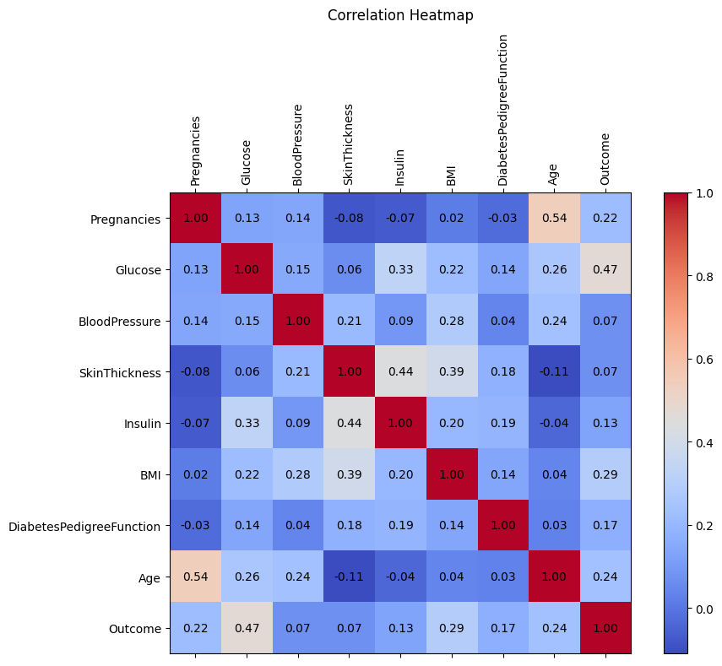
Correlation Heatmap
The data shows that ‘Glucose’ has the highest positive correlation to ‘Outcome’
‘SkinThickness’ and ‘Insulin’ levels also show a considerable correlation.
‘Glucose’, ‘BloodPressure’, ‘SkinThickness’ and ‘BMI’ also show a slight correlation with each other.
Notes:
What does the data show? Glucose has the strongest positive correlation with diabetes, while BMI, Age and Pregnancy have a slight correlation. The rest have a weak or zero correlation.

Slide 8
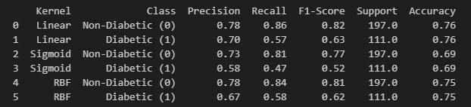
"Comparative Analysis of SVM Kernels for Diabetes Prediction"
To replace NaN values, we decided on using SimpleImputer(strategy = median) because this method is robust to outliers, and many medical features, as shown in the EDA, are right-skewed; the median gives a better central value. We aim to prevent data loss while maintaining realistic values that are not influenced by outliers.
StandardScaler was used as it ensures each feature contributes equally.
Notes:
Linear and rbf have higher accuracy (~74%) compared to sigmoid (~66%)
In class 0 (non-diabetic): High Recall for both linear and rbf (84-86%) and also high precision (78%). Class 0 is well-predicted across all kernels.
In class 1 (diabetic): Linear has the best F1 score (82%) and highest precision (70%). rbf has slightly higher recall at (58%).
We use Linear as it gives us the best results in average.

Slide 9
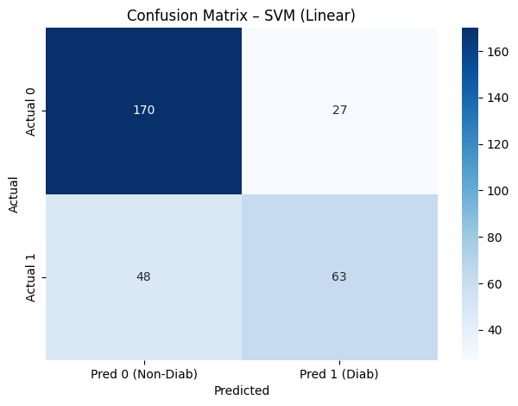
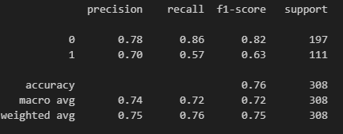
SVM model results: What does it say?
There are 170 non-diabetics (TN)
63 diabetics received the correct diagnosis (TP)
27 patients who were healthy were wrongly labelled as diabetic (FP)
48 diabetic patients were missed and labelled as healthy (FN) --- this is highly critical in healthcare!
Better overall results for non-diabetics are to be expected, as there are more non-diabetics in the dataset
233 out of 308 predictions were correct (76% accuracy).

Slide 10

Neural Network Model Application
Notes:
What does the data show? Glucose has the strongest positive correlation with diabetes, while BMI, Age and Pregnancy have a slight correlation. The rest have a weak or zero correlation.

Slide 11
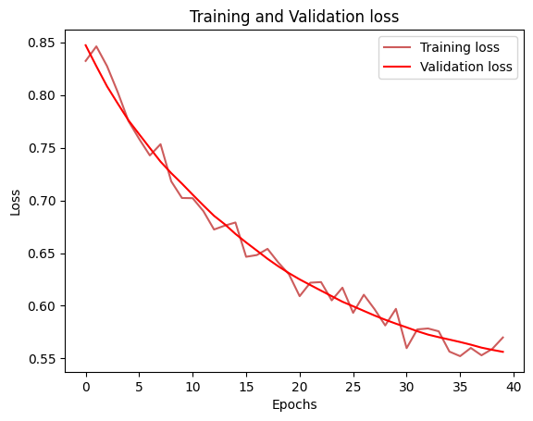
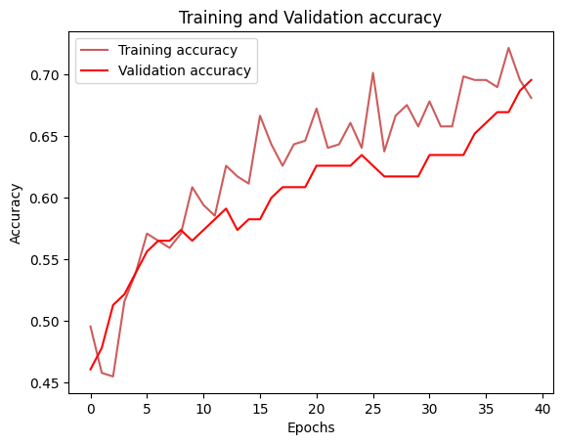
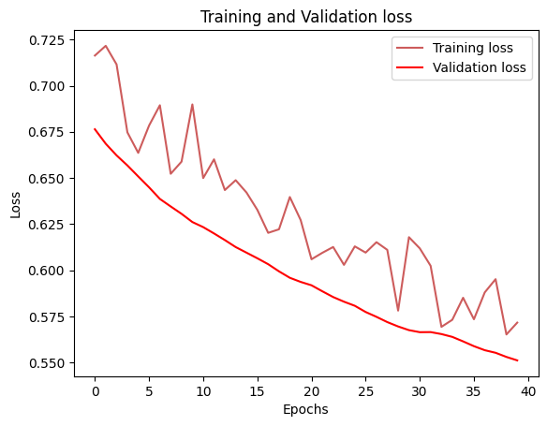
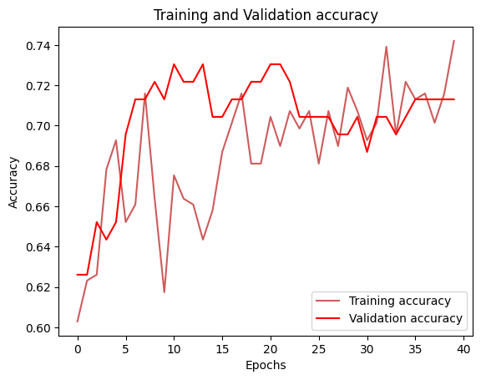
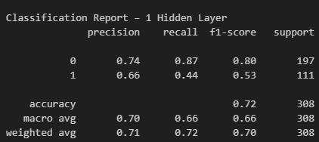
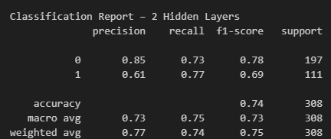
Neural Networks Results
1 layer (val_accuracy = 60.52%
2 layers (val_accuracy= 70.24%)

Slide 12
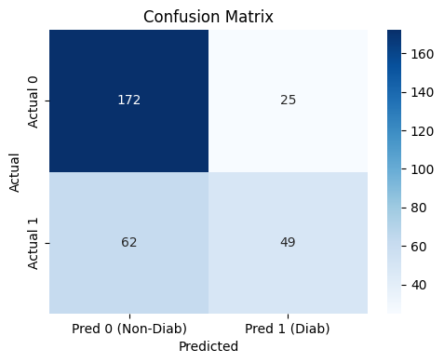
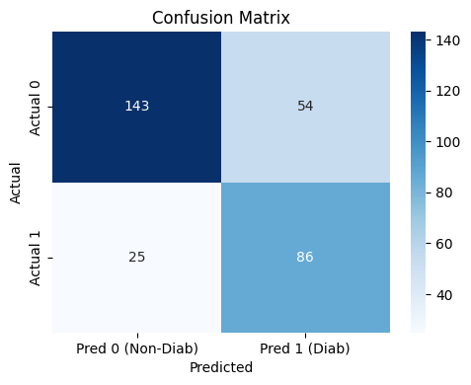
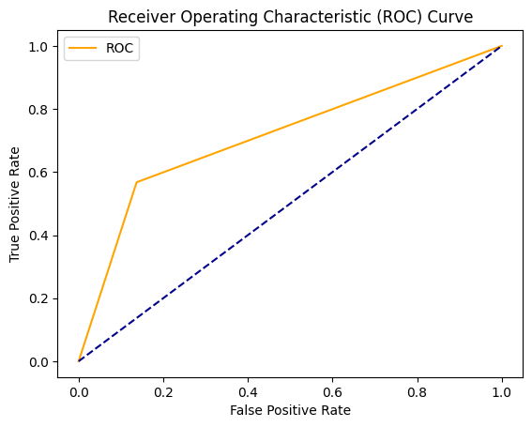
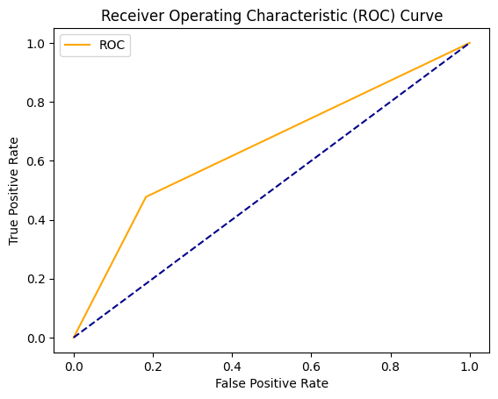
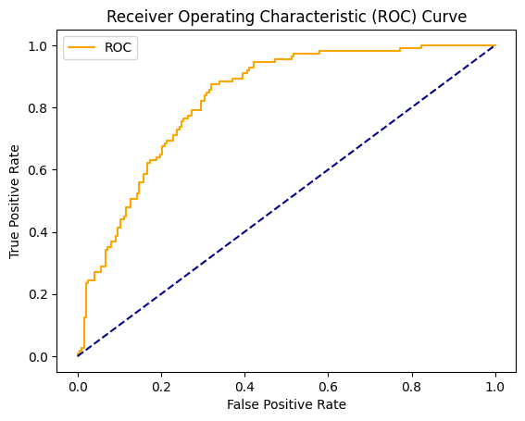
Which model to use? SVM, one-layer or two-layer neural network model?
SVM Model(Linear)
1 Layer NN
2 LAYERS NN
✅

Slide 13
CONCLUSIONS
Best precision for diabetics(1) is SVM (70% predictions are correct); however, accuracy is not the best metric, as accuracy could be misleading with an imbalanced dataset like this one. The area under the ROC curve is just above the diagonal, indicating a slight improvement over random.
The 1-layer NN model produced the worst recall and F1-score for diabetics, meaning it missed the most cases of diabetes as a false negative. The area under the ROC curve is just above the diagonal, indicating a slight improvement over random.
Best recall for diabetics(1) is the 2-layer NN (identifies 77% of diabetics with only 25 missed) and has the highest F1 score, which is crucial in diabetes detection. The large area under the curve indicates that the model distinguishes classes well.
In conclusion, the 2-layer NN should be utilised for this dataset. However, it did not provide the highest accuracy and the worst precision. In the real world, especially for medical use, it is better to have false alarms (false positives) than to miss real diabetic cases(false negatives).

